Slide 1
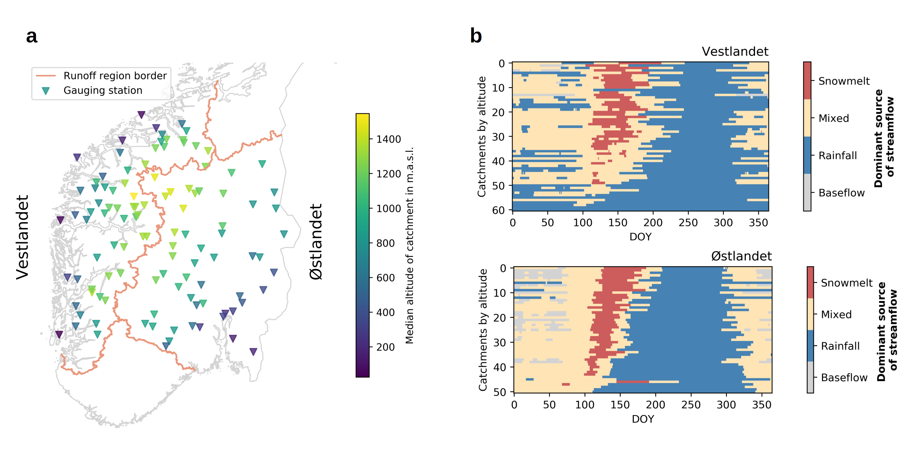
Figure 1

Slide 2
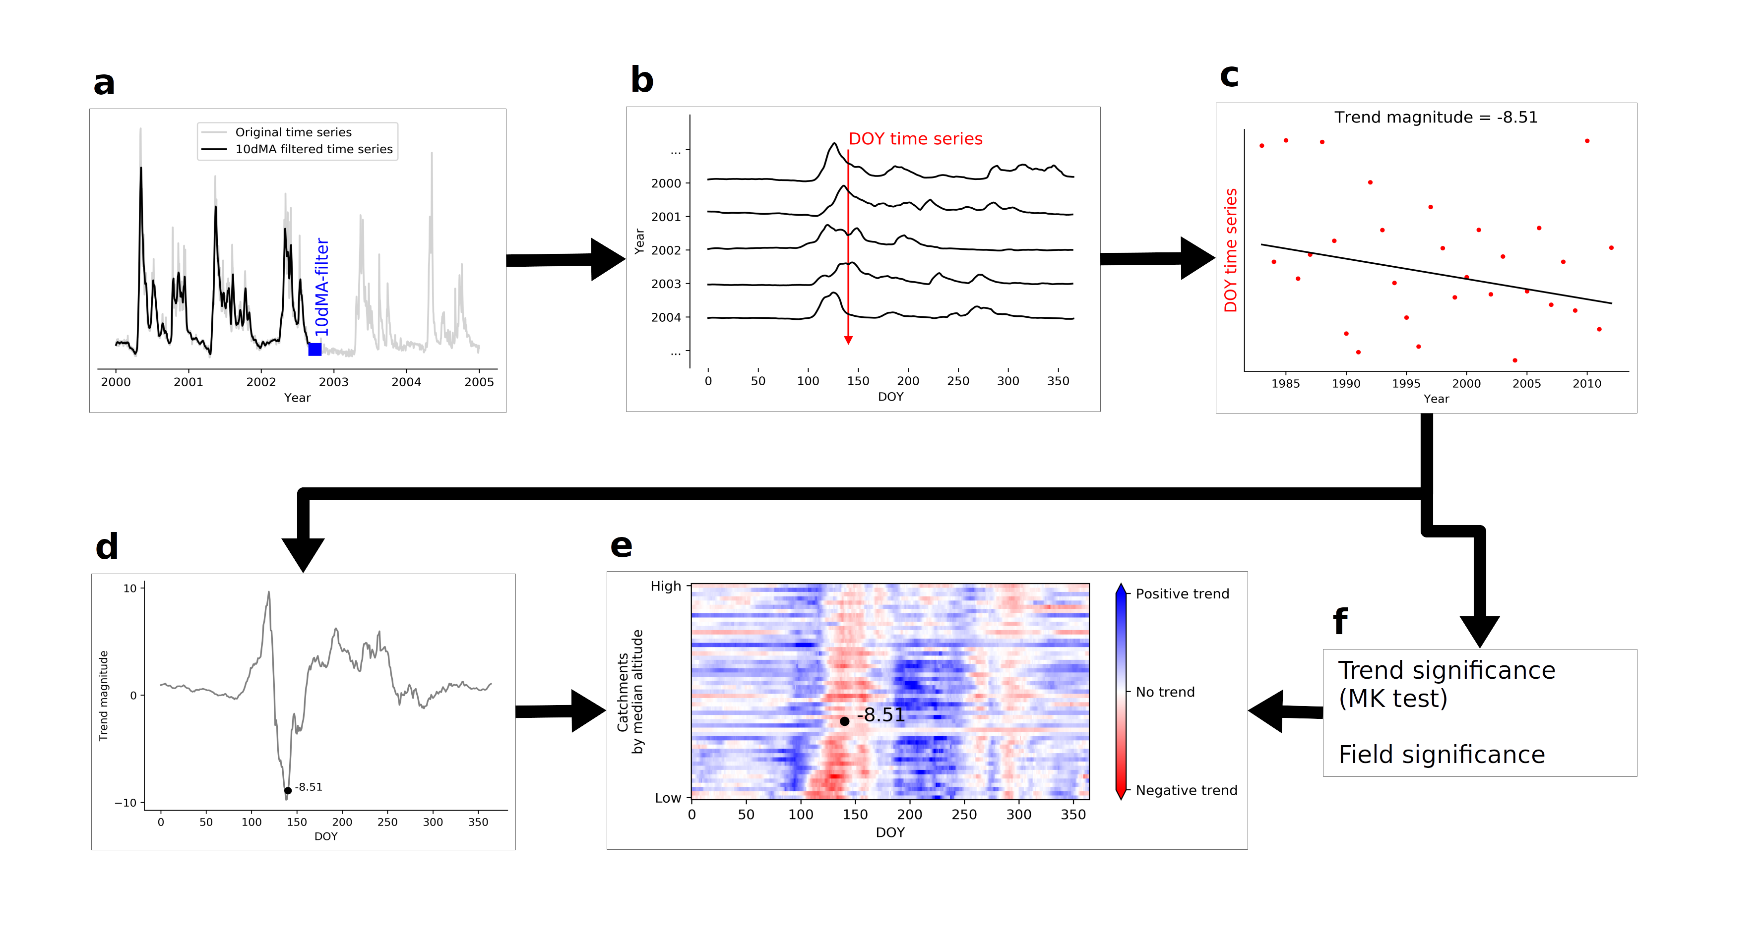
Figure 2: Method

Slide 3
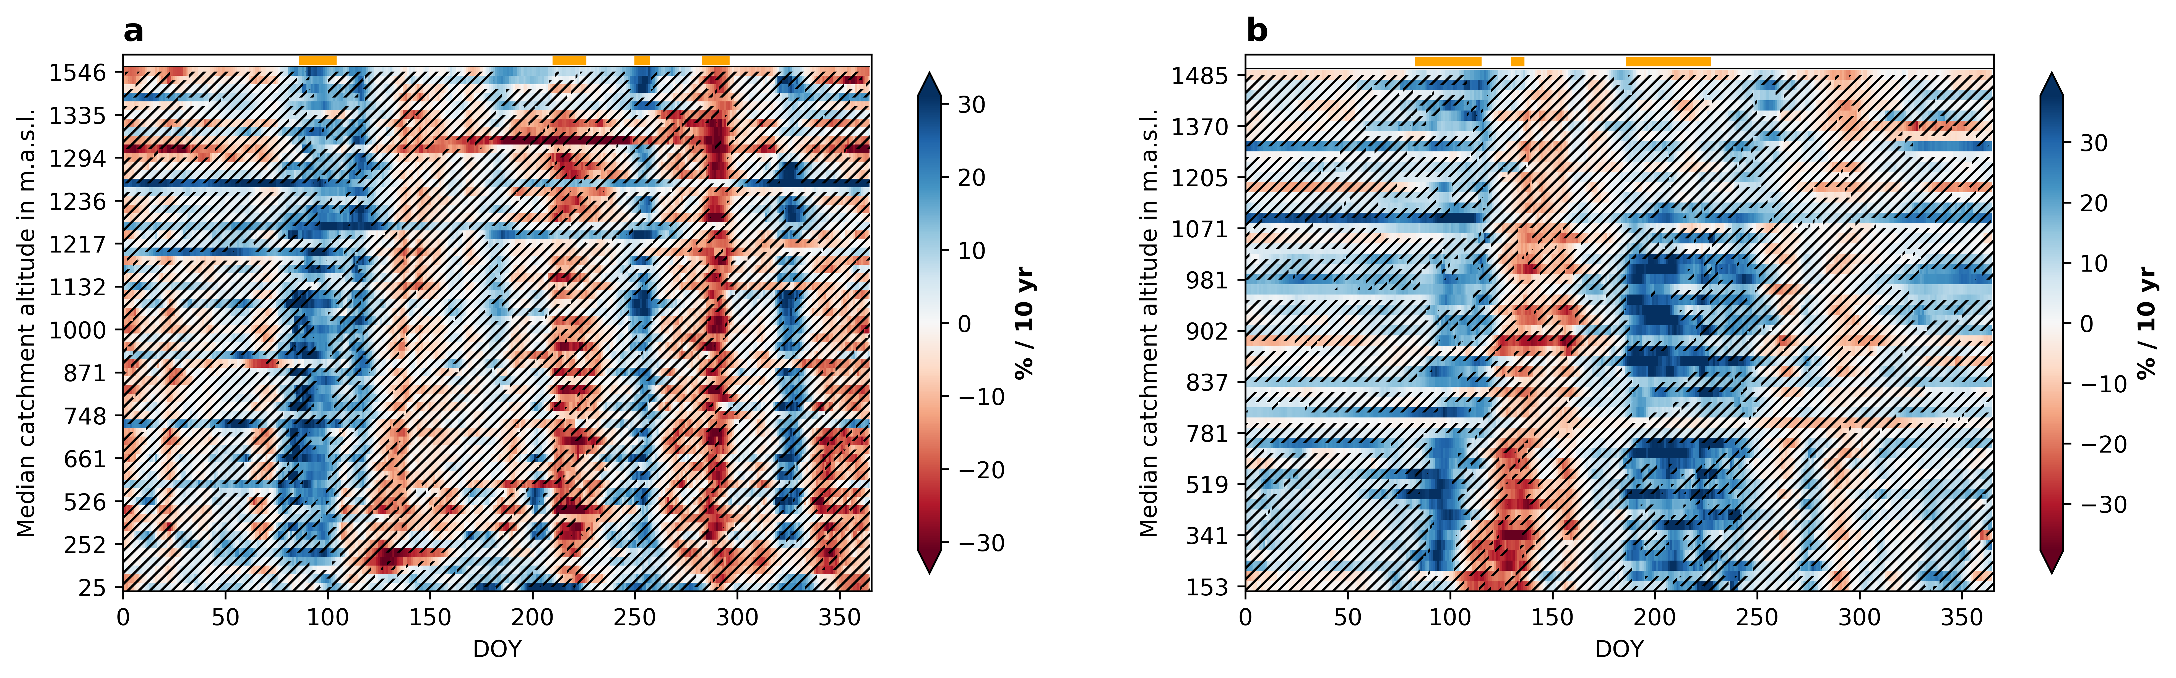
Figure 3: Streamflow trends

Slide 4
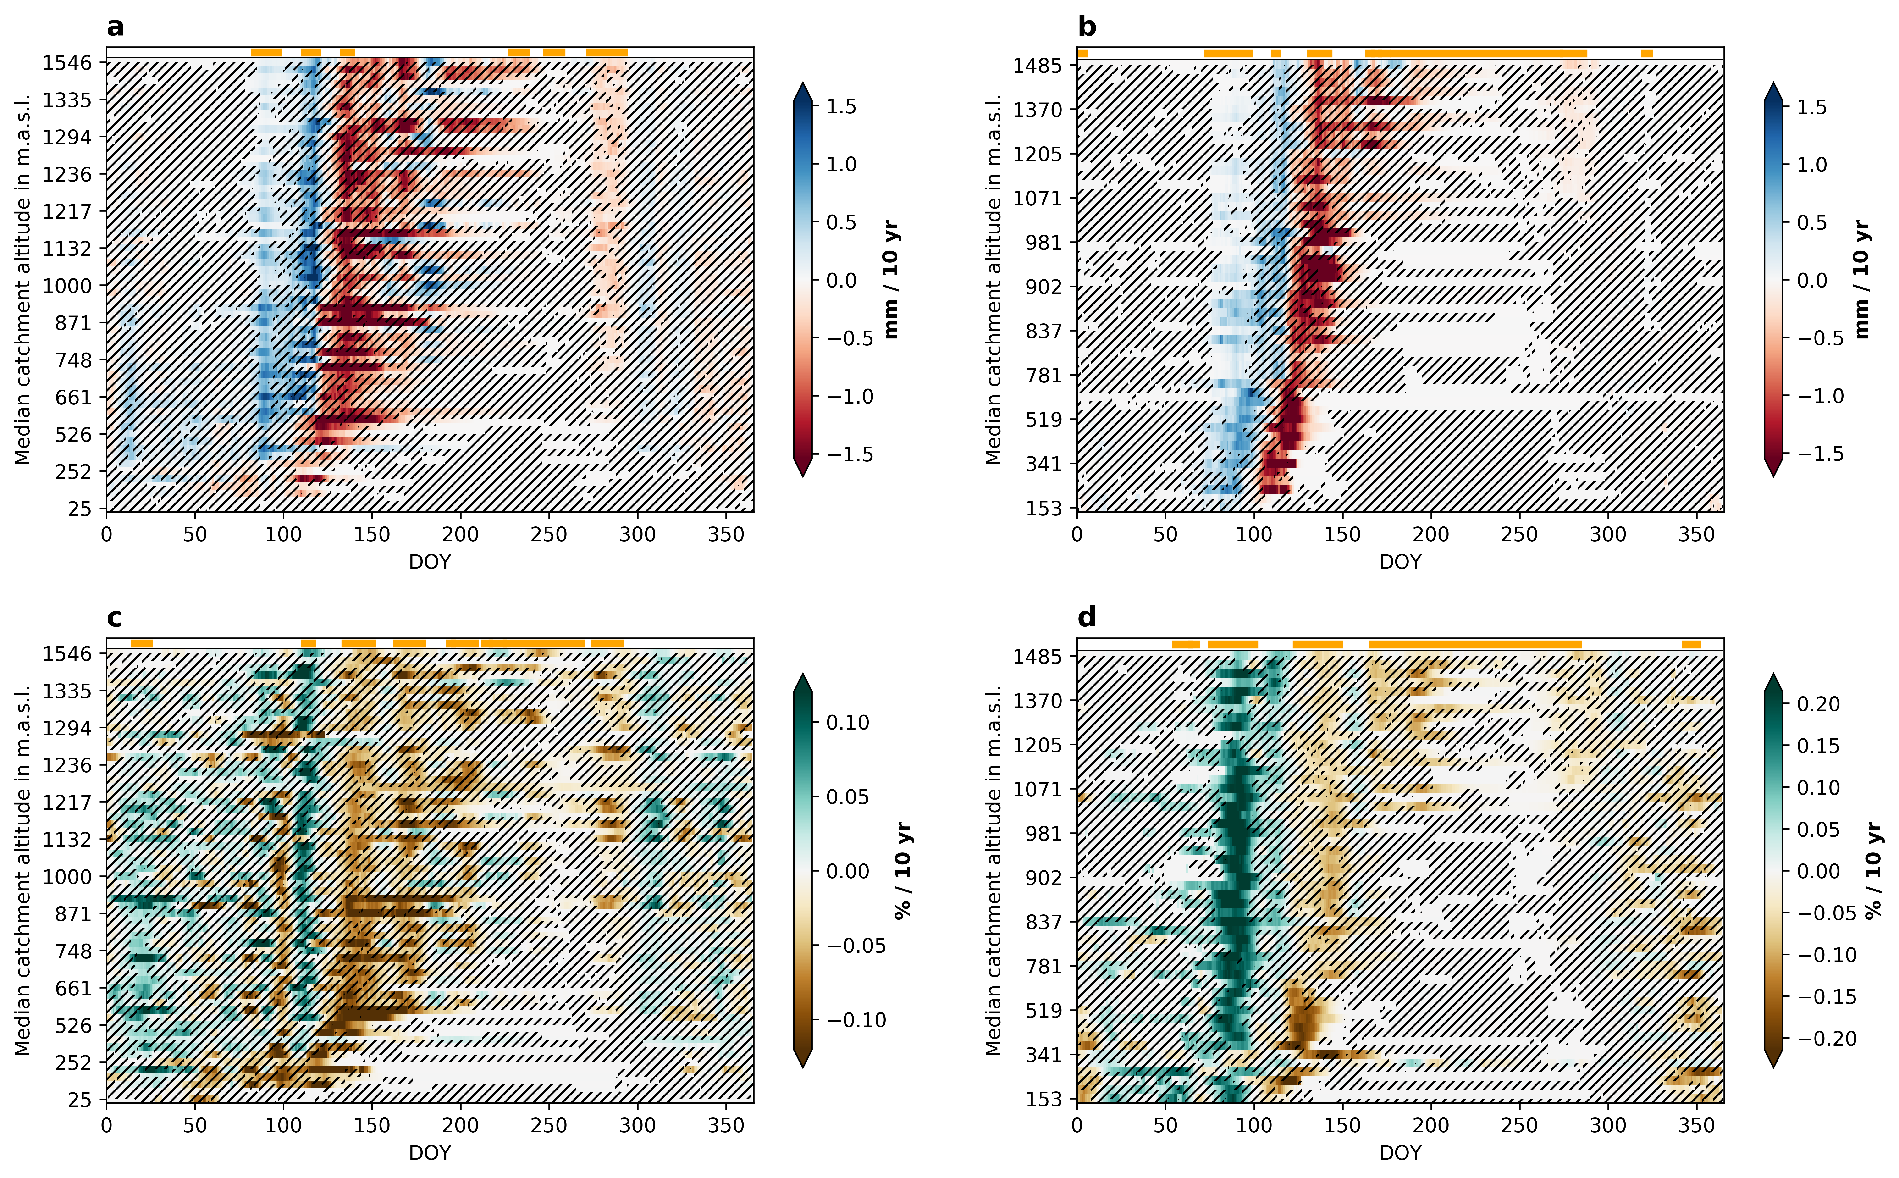
Figure 4: Snowmelt trends

Slide 5
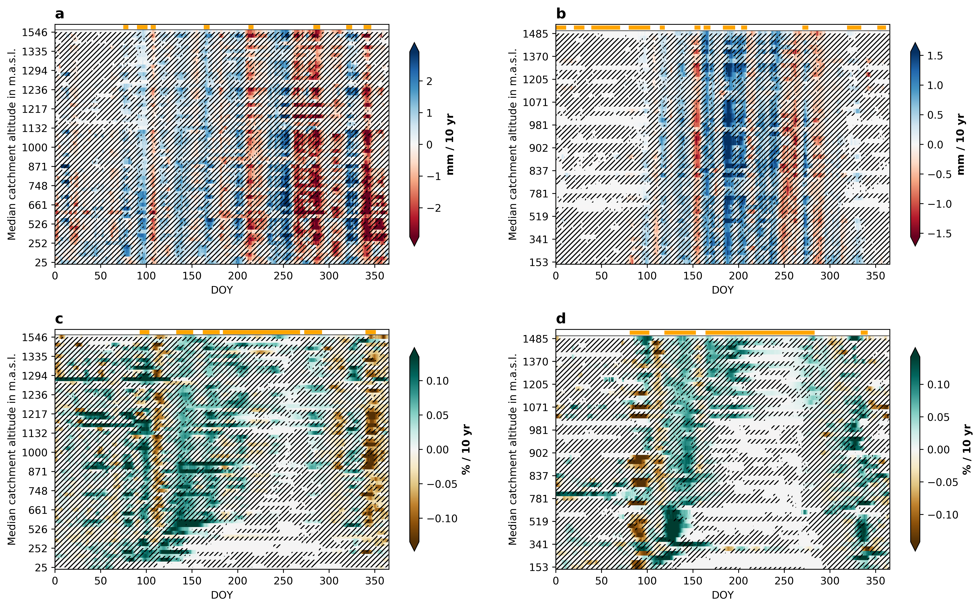
Figure 5: Rainfall trends

Slide 6
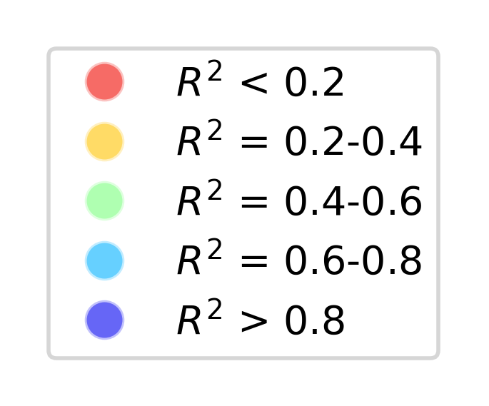
Figure 6: Attribution

Slide 7
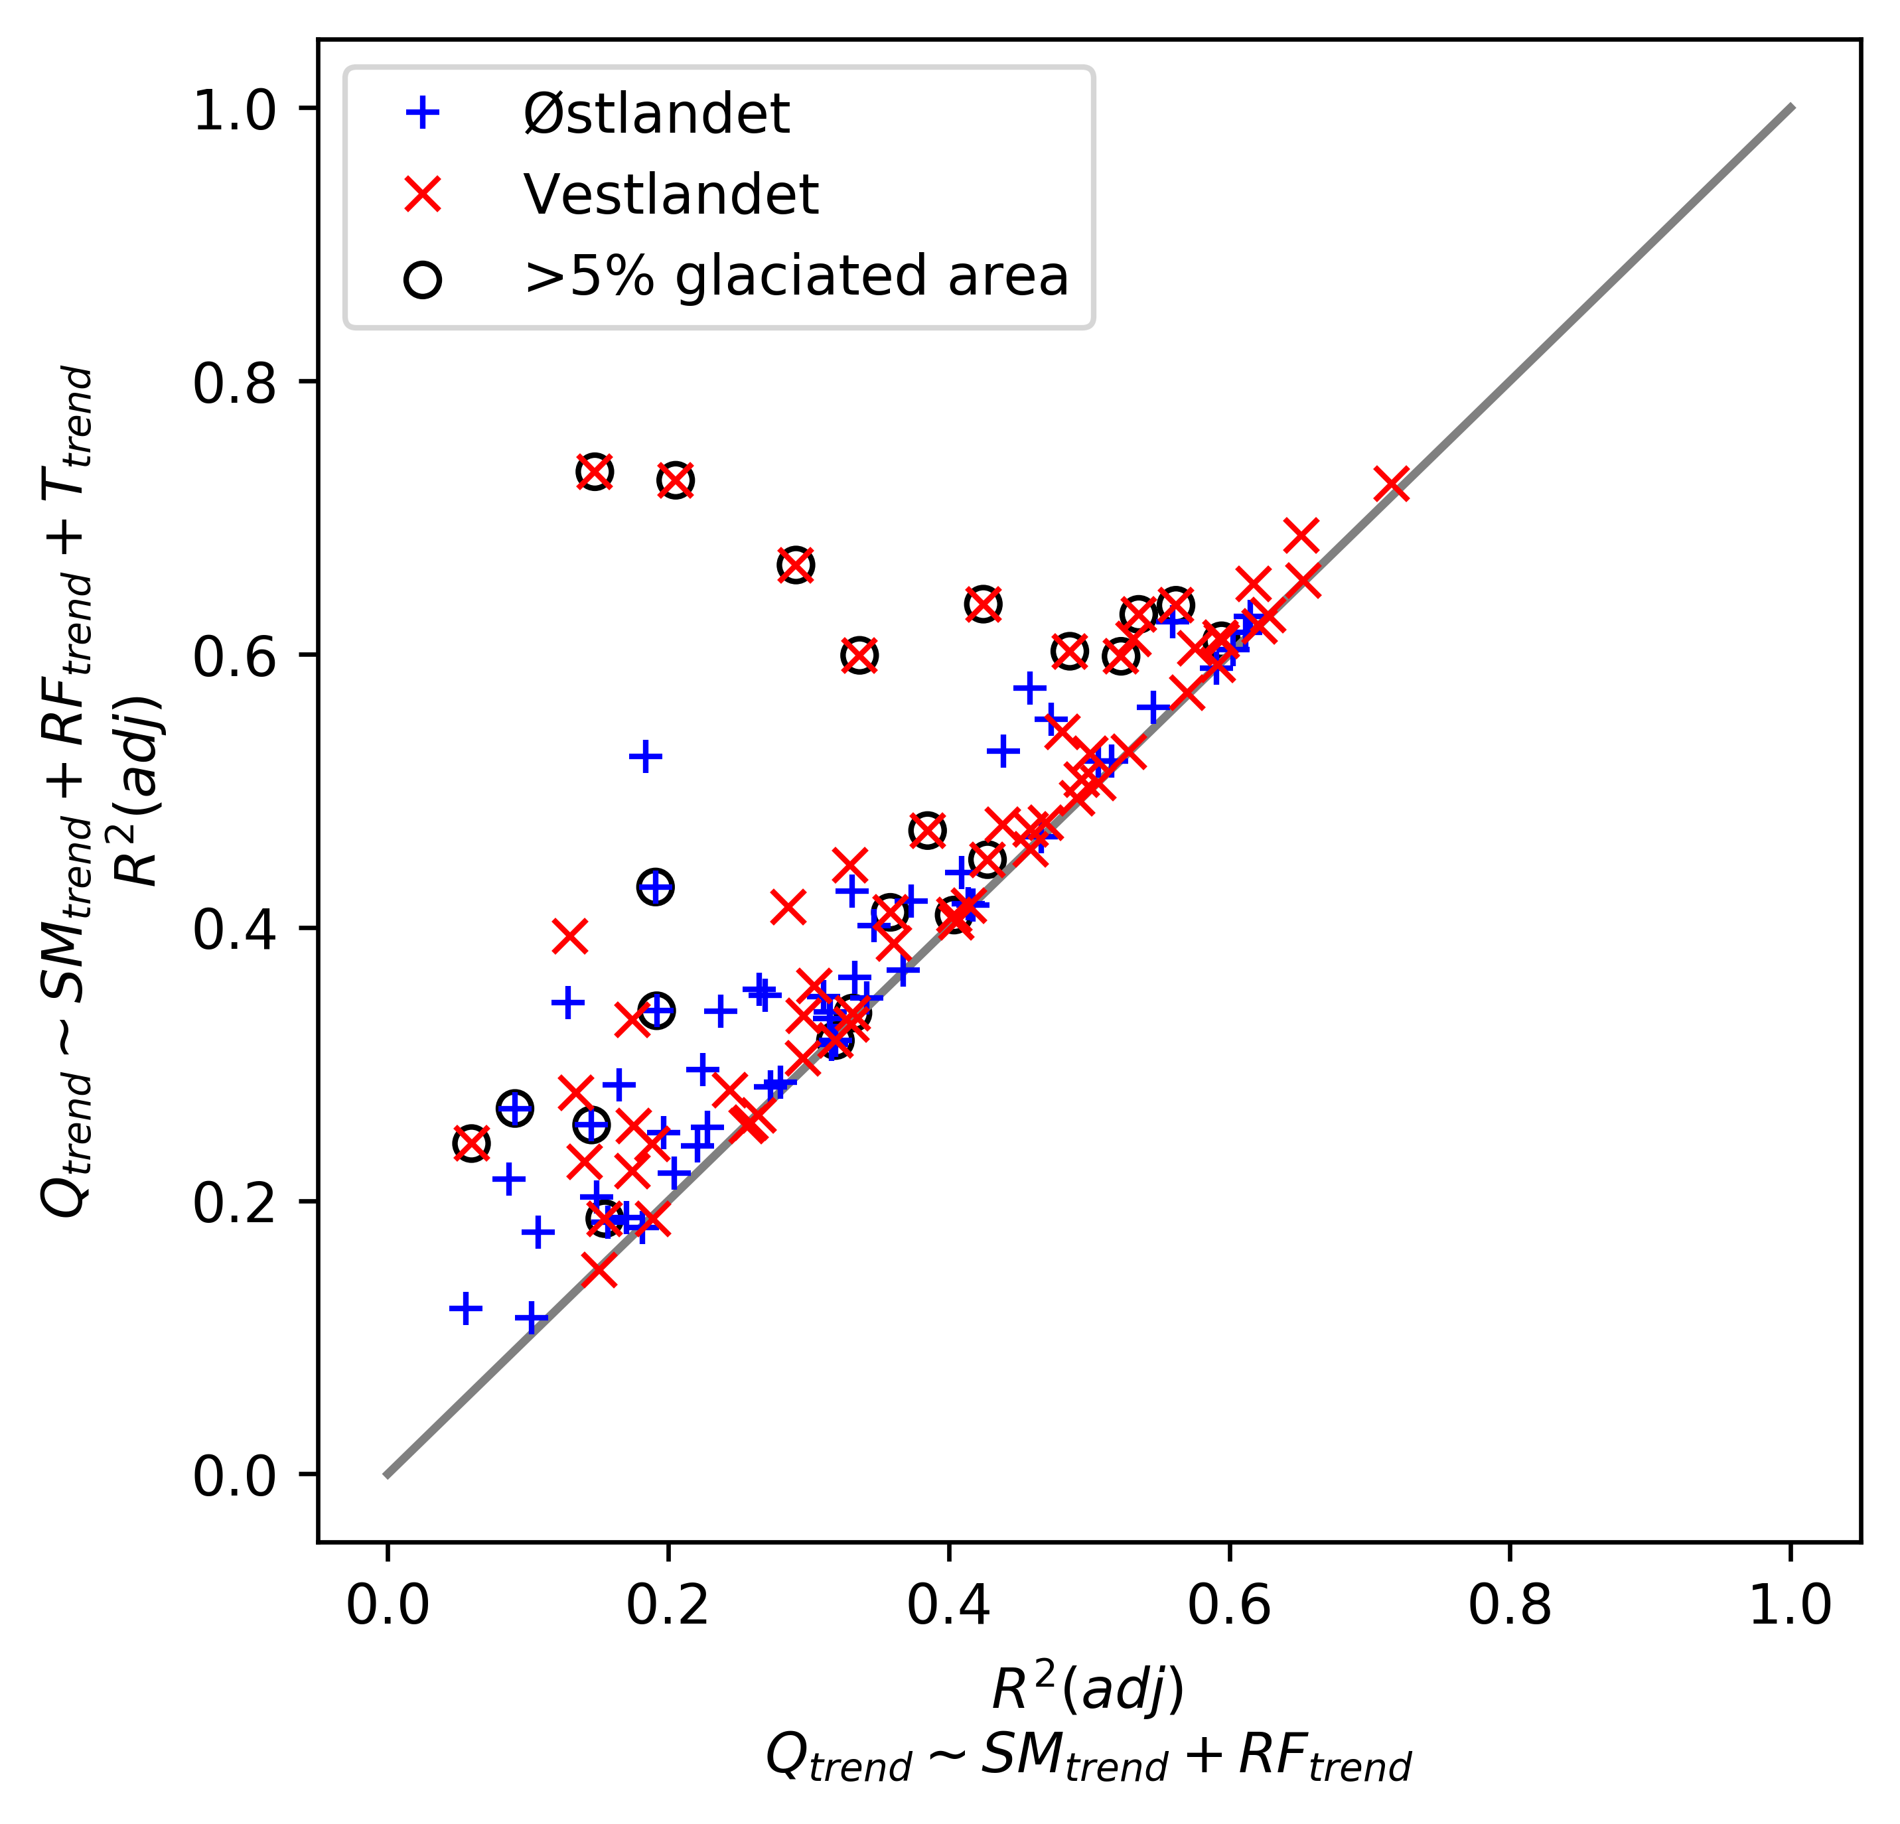
Additional

